Slide 1
OPENCV
AI CLUB
Intro to Computer Vision

Slide 2
01
OPENCV

Slide 3
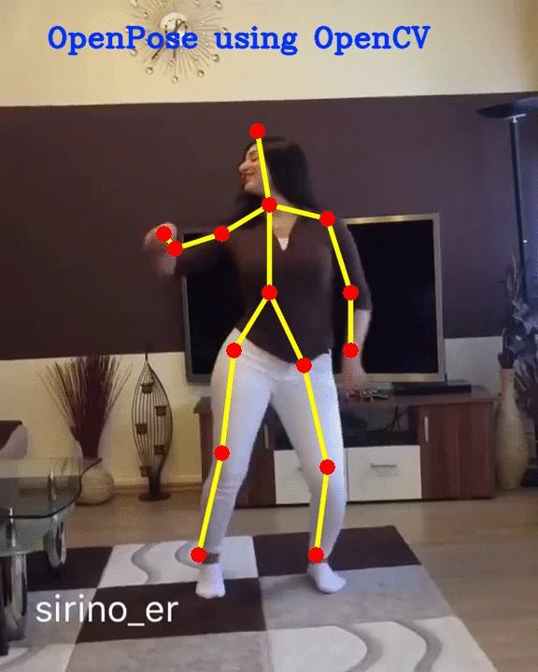
INTRODUCTION
OpenCV (Open Source Computer Vision Library) is an open source computer vision and machine learning software library
It can be used to perform tasks like face detection, objection tracking, landmark detection, and much more
It supports multiple languages including python, java, C++

Slide 4
WHY IS OPENCV RELEVANT TO AI?
PROCESSING
VISION
When working with images in AI, there is a need to perform data cleaning using image manipulation skills
Computer Vision is an important branch of AI and deals with using images in various AI and ML applications

Slide 5
02
Image Representation

Slide 6
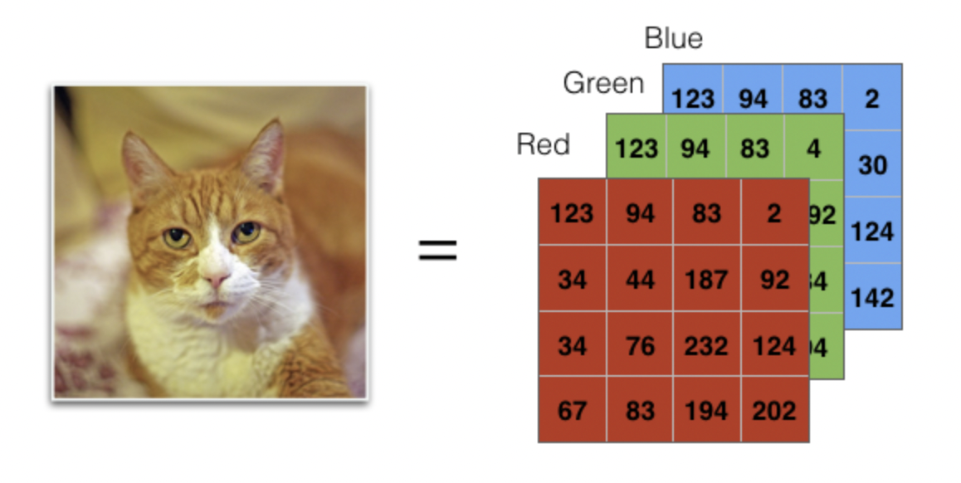
How OpenCV stores images

Slide 7
How OpenCV stores images
We need three numbers to represent the color of a single pixel. (Red, green, and blue are the primary colors on a computer screen.)
There are (height × width) pixels in an image
So we store each image as a (height × width × 3 channel) block of numbers
Example Shape: (2560, 1920, 3)
2560 rows (height) × 1920 columns (width) × 3 color channels

Slide 8
FILTER CONTEST
Try out your soon-to-be learnt image manipulation skills in OpenCV and use your creativity to create fun filters!!

Slide 9
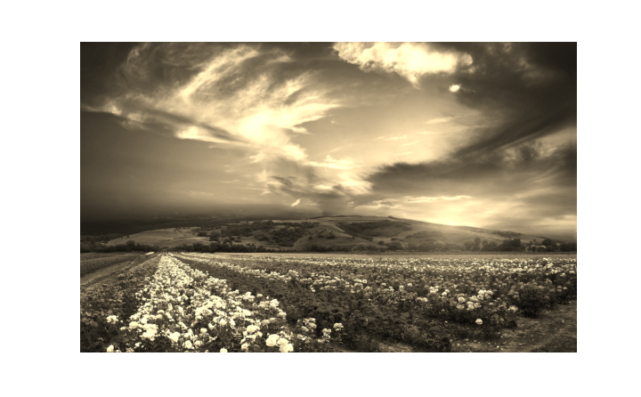
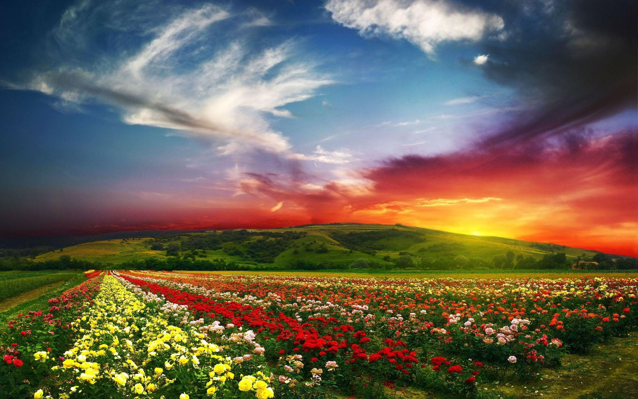
EXAMPLE FILTER
Are you excited to make your own?

Slide 10
TOP 3 FILTERS WILL BE SELECTED
Newsletter feature
Bragging rights

